Slide 1
Software Engineering
Week 12 Lecture 01

Slide 2
SOFTWARE TESTING STRATEGIES
A plan that outlines the testing objectives, methods, and activities to be followed for a software project.
Provides a roadmap for the testing process, ensuring that the right types of tests are performed at various stages of the SDLC.

Slide 3
Integration Testing
A type of software testing in which the different units, modules or components of a software application are tested as a combined entity.
But if they all work individually, why do you doubt that they’ll work when we put them together?
The problem, of course, is “putting them together”—interfacing.

Slide 4
Integration Testing [contd..]
Example: Application has 3 modules say, ‘Login Page’, ‘Items’ and ‘Item details’ and each of them is integrated logically.
We will not concentrate on the individual page here (as it’s already done in unit testing), instead we will check how they are linked to each other.

Slide 5
Integration Testing [contd..]
Test Case ID | Test Case Objective | Test Case Description | Expected Result
1 | Check the interface link between the Login and Items module | Enter login credentials and click on the Login button | To be directed to the Items
2 | Check the interface link between the Items and Item Details Module | From Items select the Item and click a details button | Details of the selected item should appear

Slide 6
Integration Testing [contd..]
Types of Integration Testing:
Top-Down Integration
Bottom-Up Integration
Big Bang Integration

Slide 7
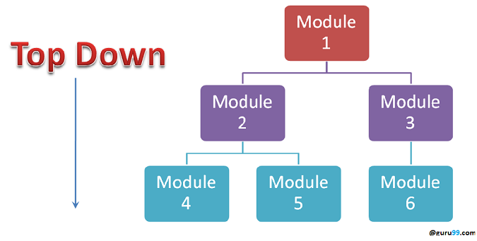
Integration Testing [contd..]
Top-Down Integration
Testing starts with the highest-level components/modules and progresses downwards.
Stub or dummy implementations are used for the lower-level components that are not yet integrated.
Allows for early testing of higher-level functionalities and facilitates early bug detection.
Notes:
Highest priority – Highest level

Slide 8
Integration Testing [contd..]
Top-Down Integration
High-level components | Low-level components
Typically, closer to the hardware or system infrastructure. | Closer to the user interface or the application's main functionalities.
OR Modules with highest priority | OR Modules with lesser priority
Database access layer or hardware interaction modules etc. | User management modules or payment processing modules etc.
Notes:
Highest priority – Highest level

Slide 9
Integration Testing [contd..]
Top-Down Integration
Example: Consider a website with the following components:
Shopping Cart Module
Payment Gateway Module
User Authentication Module
User Interface (UI)
Product Catalog Module
4
5
2
1
3

Slide 10

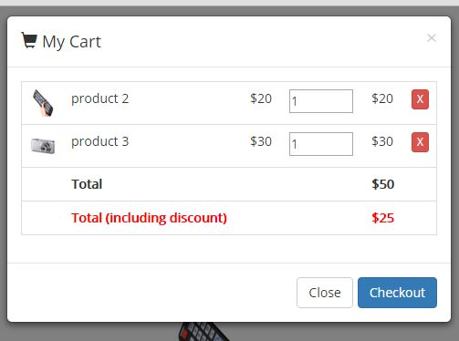

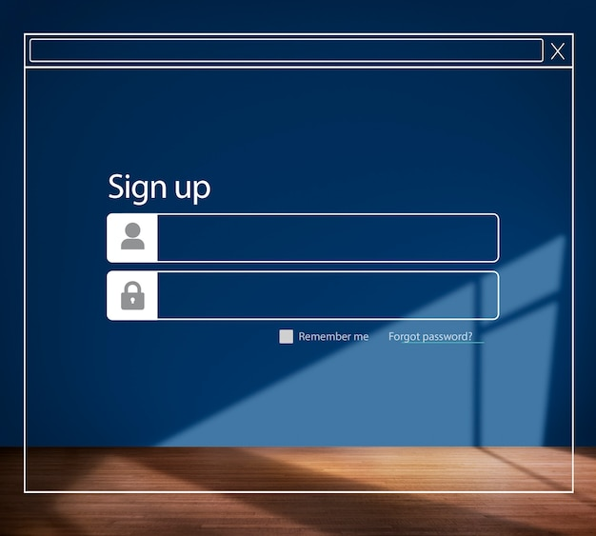

Integration Testing [contd..]
Products Catalog
Shopping Cart
Top-Down Integration
U-shop
U-Shop
Front page UI
User authentication
Payment Gateway
Notes:
1- check navigation, layout, and user interaction, perform basic user actions like clicking buttons or entering data.
2- Integrate, test and Verify that user authentication and login functionalities work as expected.
3- Integrate, test and Verify that the product catalog is displayed correctly on the UI.
4- products can be added to the cart, cart total is updated correctly, and items can be removed from the cart.
5- Verify that the payment process is smooth and secure.

Slide 11
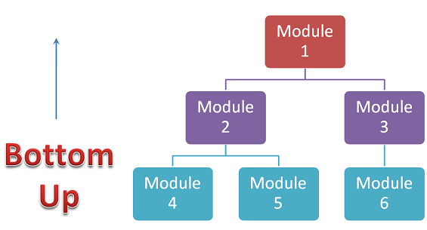
Integration Testing [contd..]
Bottom-Up Integration
Testing starts with the lowest-level components/modules as clusters and progresses upwards.
Drivers are used for the higher-level components that are not yet integrated.
Allows for early testing of lower-level functionalities and facilitates early bug detection.
Notes:
integration testing approach should be based on analysis of the system's architecture, dependencies, complexity, and project constraints

Slide 12
Integration Testing [contd..]
Big Bang Integration
All the individual components of a system are combined and tested together simultaneously.
In this approach, the integration testing phase occurs as a single event, usually towards the end of the development process.

Slide 13
Integration Testing [contd..]
Big Bang Integration:
Consider an e-commerce website with the following components:
User Registration Module
Product Catalog Module
Shopping Cart Module
Payment Gateway Integration

Slide 14
Integration Testing [contd..]
Big Bang Integration:
With the Big Bang Integration approach, all these modules are developed independently and tested individually.
Once all the modules are ready, they are integrated together in a single event, and the entire system is tested.

Slide 15
Integration Testing [contd..]
Big Bang Integration:
Advantages | Disadvantages
Quick integration | Late detection of issues
Simplicity | Limited visibility
Flexibility
Notes:
1.3 No strict integration dependencies.
2.2 Difficult to identify the root cause of any failures or errors.

Slide 16
System Testing
A type of software testing that evaluates the complete and integrated system.
Focuses on testing the system's behavior and functionality against the specified requirements.

Slide 17
System Testing [contd..]
Types of system testing:
Recovery Testing
Security Testing
Stress Testing
Performance Testing
Deployment Testing

Slide 18
System Testing [contd..]
Recovery Testing is a system test that forces the software to fail in a variety of ways and verifies that recovery is properly performed.
If recovery is not automatic and require human intervention, the time is measured to determine if it is in acceptable limits.

Slide 19
System Testing [contd..]
Security Testing validates the system's security measures and identify potential vulnerabilities or weaknesses.
This involves testing authentication, access controls, data encryption, and protection against common security threats.
Notes:
Hackers are hired

Slide 20
System Testing [contd..]
Stress Testing executes a system in a manner that demands resources in abnormal quantity, frequency, or volume.
For example, input data rates may be increased by an order of magnitude to determine how input functions will respond
Notes:
Heavy load on the website

Slide 21
System Testing [contd..]
Performance Testing evaluates the system's performance under expected workloads and stress conditions.
This includes testing response times, throughput, resource utilization, and scalability.
Notes:
often coupled with stress testing

Slide 22
System Testing [contd..]
Deployment Testing exercises the software in each environment in which it is to operate.
Because the software must execute on a variety of platforms and under more than one operating system environment.

